Slide 1
Device level thermal characterization for electronic and photonics devices
Dr. Mo Shakouri
Chairman
Microsanj, LLC., Silicon Valley USA
info@microsanj.com

Slide 2
Applications

Slide 3
Outline
Challenges on thermal characterization
  For electronic, photonic and power devices
Thermoreflectance method
  Method and equipment
Example of various cases
  Hot spot needs a spatial resolution
  Transient response (100s μs) tells the logic sequences
  Emission overlay gives location of electron collisions
  Heat diffuses through the metal layers
  Thermal information provide potential
  Thermal map changes before device fails
  HBT Thermal Image
  Non-uniform device turn on in a symmetrical Silicon Controlled Rectifier
Photonics and power devices
  LED - Single junction, encapsulation, multi junction
  Multi junction PV cell
  InP laser device (cross section)
  Power transistor array
Summary

Slide 4
Challenges on thermal characterization
General challenges for electronics devices
Small features: 10s nm – 100s microns – difficult to contact
High speed response due to the small thermal mass
Highly non-uniform
Additional challenges for photonics and power devices
Light emission (photonics)
High heat density
Heat sinks requirement (power devices)

Slide 5
Non-contact and transient thermal-imaging
THERMAL TRANSIENT [Sec]
FASTER
10⁻¹²
10⁻⁹
10⁻⁶
10⁻³
10⁰
10
SLOWER
DIMENSIONS [m]
SMALLER
10⁻⁹
10⁻⁶
10⁻³
10⁻²
LARGER
1-D hotspot
ESD
S.L. Cooler
IC arrays
TE Modules
TIM
Single
Tr
Logic Chips
DEVICE / TECHNOLOGY
Nano
wires
thin film
substrate level
Pkg.
Motivations
Scaling on space and time
Moving hotspots – issue of scanning methods
Size of hot spots – issue on thermo couples/point sensors.

Slide 6
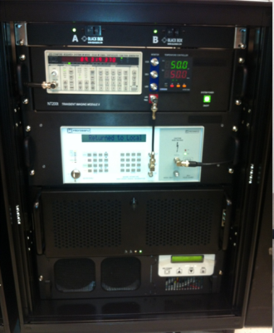
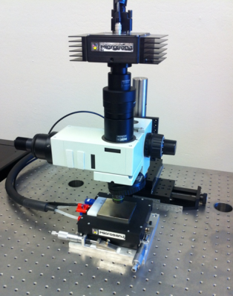
Thermoreflectance imaging setup
Console box
Microscope setup
CCD
Sig. gen.
Temp. contl.
LED
Control box.
Objective lens
DUT

Slide 7
How it works - thermoreflectance
LED driver
GP-IB
Power LED
PC
Light
Detector
CCD, InGaAs
Microscope
Objective
Pulse generator & power amp
Device
Thermal bed
Thermoreflectance coefficient
System diagram

Slide 8
Lock-in signals
Timing chart
4ms @ 25% Duty Cycle
t₀
Device Excitation
1ms
CCD exposure
33ms @ 30Hz
delay
t₀
100μs
t₁
t₁
LED pulse
Temperature
Acquisition timing (shifting by cycle)
Temperature data point along the bias cycle

Slide 9
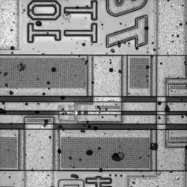
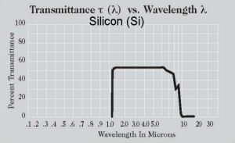
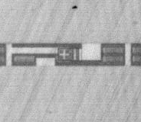
Through silicon and emission
Top view
InGaAs CCD
1300 nm
LED
Objective
Substrate
Flip Chip DUT
Transmittance vs Wavelength, Si
Bottom view
(Image from http://www.janis.com)
resolution
% Transmittance
1.0
10.0
Wavelength, μm

Slide 10
Defects and signature of potential failure
Emission – sign of high density of electron collisions
Thermal hotspot – location of potential long-term reliability
Thermal foot print → irregular local energy spot
Arrhenius's law
Transient irregular timing - potential of logic/operation failure
Near Infrared (NIR) wavelength provide a capability of both thermal signal and emission simultaneously.
LED options: 1050, 1200, 1300, and 1500 nm

Slide 11
Resolution and sensitivity
Temperature
n : number of averaging
due to the weak signal (C_{th} ~ 10⁻⁴ order)
Spatial resolution
Visible wavelengths, d ≈ 250-300 nm
NIR d ≈ 500 nm
d ≈ λ/2
Time resolution
As scaling smaller, time resolution must be smaller due to thermal diffusion.
Δt : 100ns for our setup.
(for 1% error in temperature)
Emission
InGaAs uncooled camera effective sensitivity of one pixel for emission ~ 30 mW/mm²

Slide 12
Transient thermal/emission imaging
Method | Resolution |  |  | Imag-ing? | Notes
 | x(μm) | T (K) | t (sec)
μ Thermocouple | 50 | 0.01 | 0.1-10 | No | Contact method
IR Thermography | 3-10 | 0.02-1 | 1μ | Yes | Emissivity dependent
Lock-in Thermog. | 3-10 | 1μ | NA | Yes | Need cycling
Liquid Crystal Thermography | 2-5 | 0.5 | 100 | Yes | Only near phase transition (aging issues)
Thermo-reflectance | 0.3-0.5 | 0.08 | 800p- 0.1μ | Yes | Need cycling
Optical scanning Interferometry | 0.5 | 100μ | 6n- 0.1μ | Scan | Indirect measurement (expansion)
Micro Raman | 0.5 | 1 | 10n | Scan | 3D T-distribution
Scanning thermal microscopy (SThM) | 0.05 | 0.1 | 10-100μ | Scan | Contact method surface morphology
Emission Microscopy (EMMI) | 0.25 s.im.lens | - | Op lock-in | Yes | Emitted Photon density

Slide 13
Small hotspot
a)
1.4 μm gate on MOSFET
1.4 μm gate on MOSFET
60
50
40
40
Temperature (a.u.)
30
b)
20
10
0
0
2
4
6
8
10
12
Distance (μm)

Slide 14





Transient Behavior of IC Latch-Up
Movie1
- Potential timing failure -
0.5 ms
0.7 ms
0.9 ms
1.0 ms
3.0 ms
The latch-up location is circled in yellow

Slide 15
Thermal and emission overlay images
5x
Thermal signals
Through silicon substrate, 450 μm thick.
LED λ = 1300nm and
InGaAs camera (640 x 512)
50x
Emission signals
44 μW

Slide 16
Diffusion time/depth estimations
μ: depth of heat source
α: thermal diffusivity [m²/s]
t: time to reach observing surface

Slide 17
Through silicon, deep under the 6th metal layer
Movie2
2.0 msec
0.97V, ~12mA, ~12mW 20% duty cycle
10 minutes of averaging (repeating)

Slide 18
Time delay to reach to the surface
Precise time resolution is a key to find the response.

Slide 19
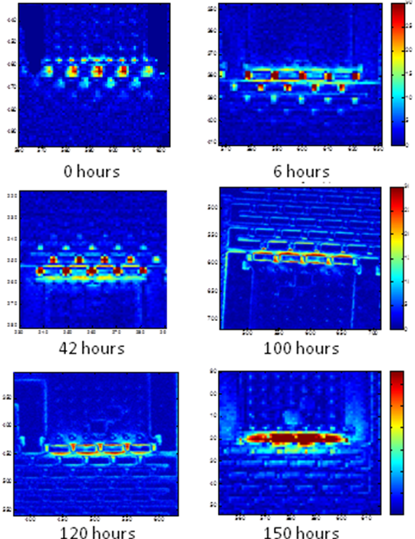
Via chain reliability
Past work on reliability analysis – oven test for φ500nm copper via through silicon.
ΔT_{via}(t)/ΔT_{via}(0)
R_{via}(t)/R_{via}(0)
K. Yazawa, D. Kendig, D. Hernandez, K. Maize, S. Alavi, A. Shakouri, “High Speed Transient Thermoreflectance Imaging of Microelectronic Devices and Circuits”, EDFA Magazine, Vol. 15, No 1. Page 12-22, (2013).

Slide 20
Power Amplifiers
Copyright 2013 Microsanj, LLC All rights reserved.

Slide 21
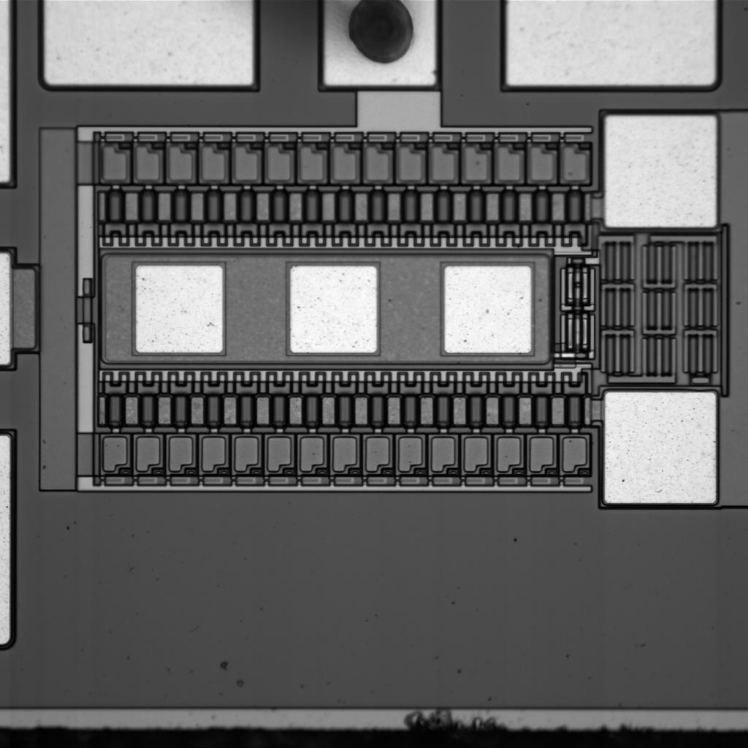
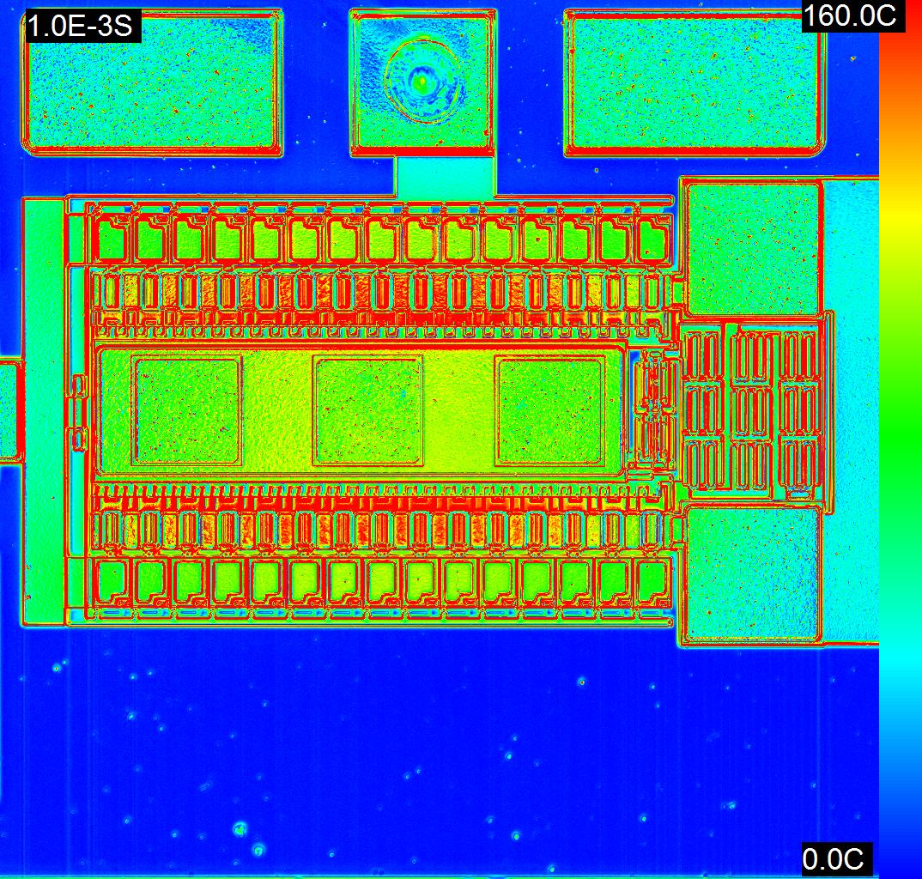
HBT Thermal Image
CCD Image
Thermal Image
20x
0.5Hz, 3.8W
380mA, 10V
∆T

Slide 22
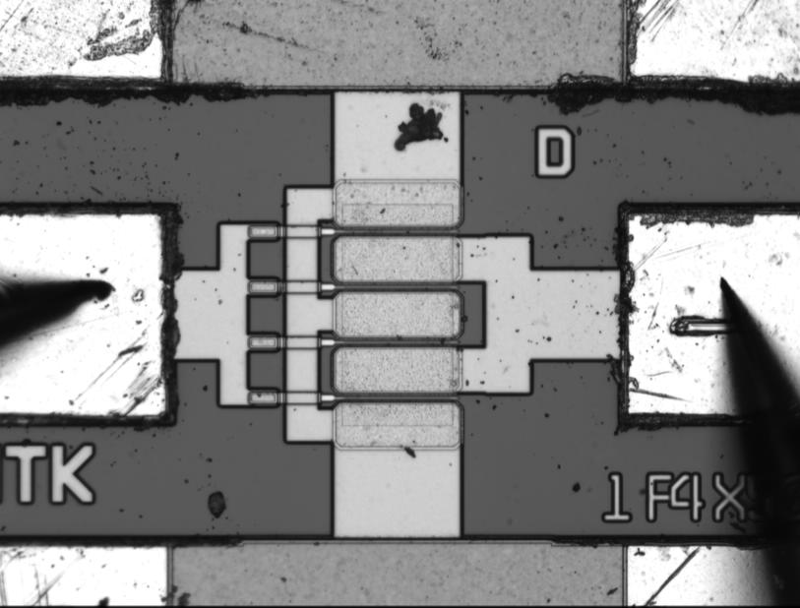
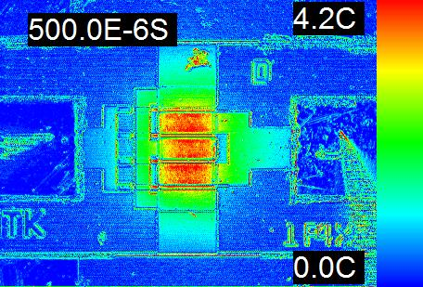
pHEMT Gate Temperature
CCD Image
Thermal Image
20x
This shows a low magnification thermoreflectance image of pHEMT

Slide 23
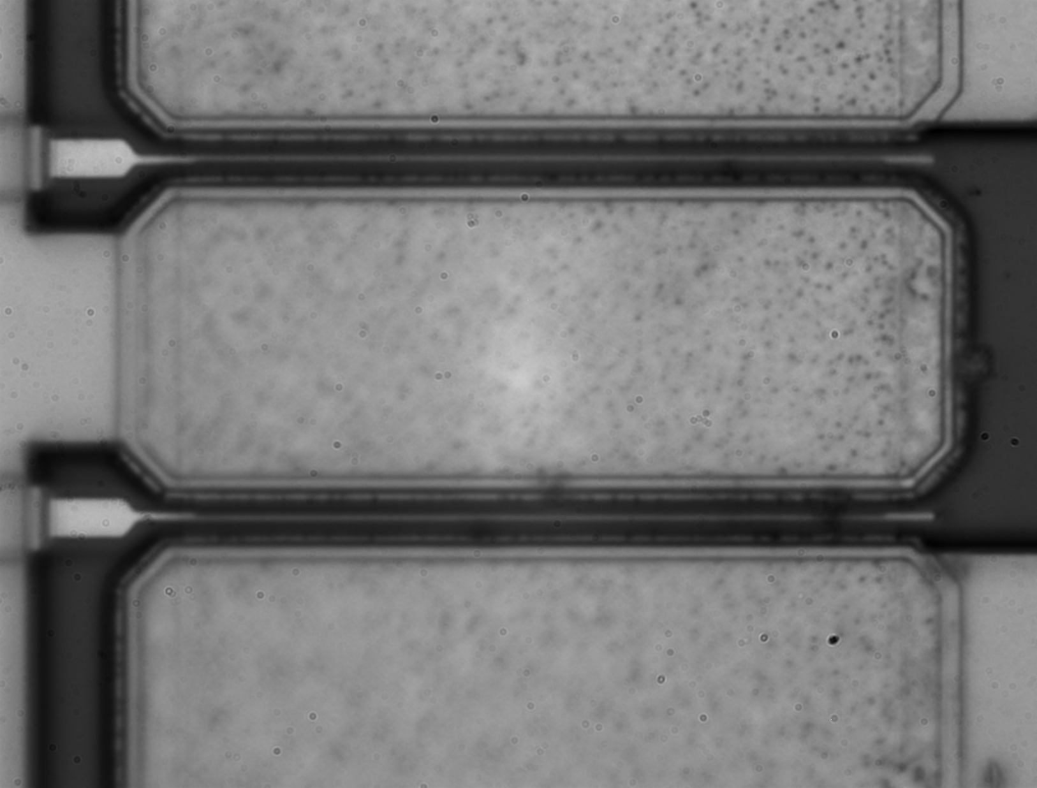
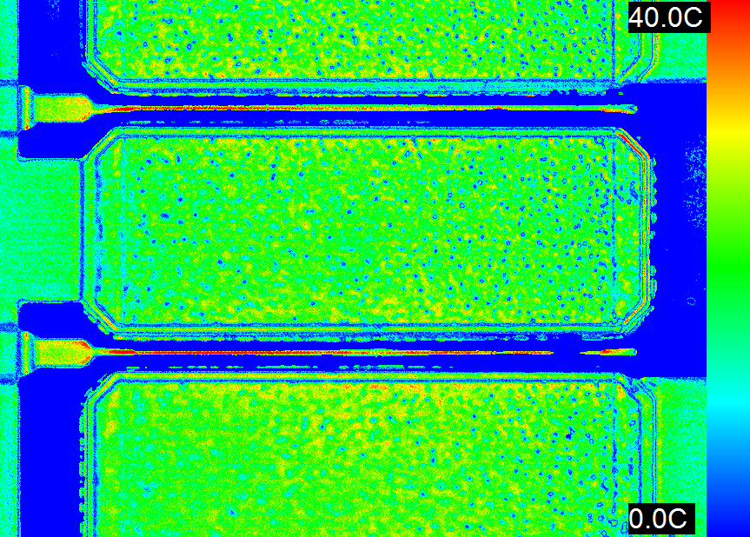
100x thermal image of gate
CCD Image
Thermal Image
(calibrated for metal only)
This shows the side temperature profile of the center of the pHEMT. The dark channel region is not calibrated for, and did not show a strong signal.

Slide 24
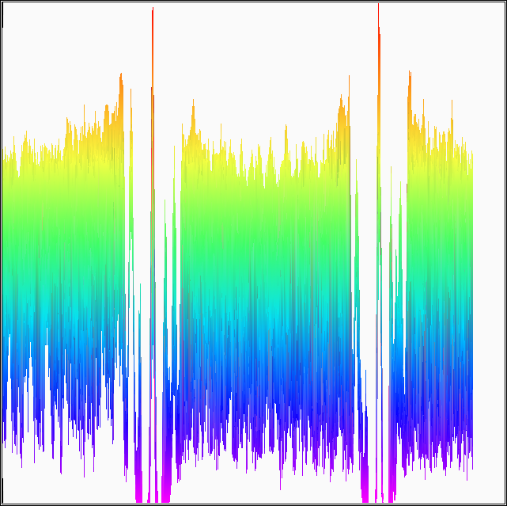
100x Side Profile
Y-Z Profile
44mA, 1V
This shows the side temperature profile of the center of the pHEMT. The dark channel region is not calibrated for, and did not show a strong signal.
(calibrated for metal only)
24

Slide 25
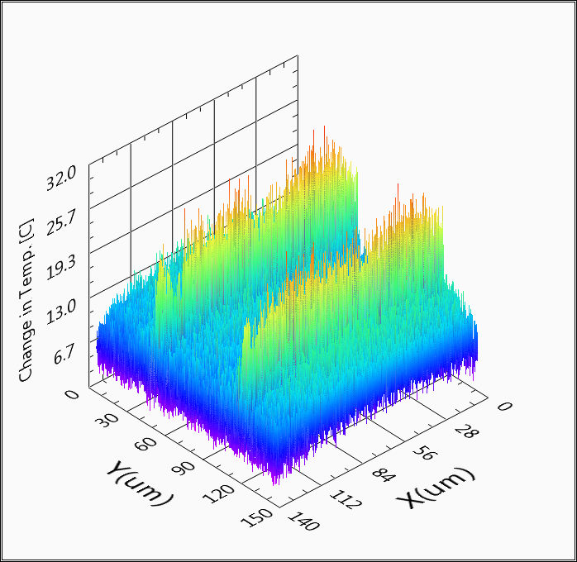
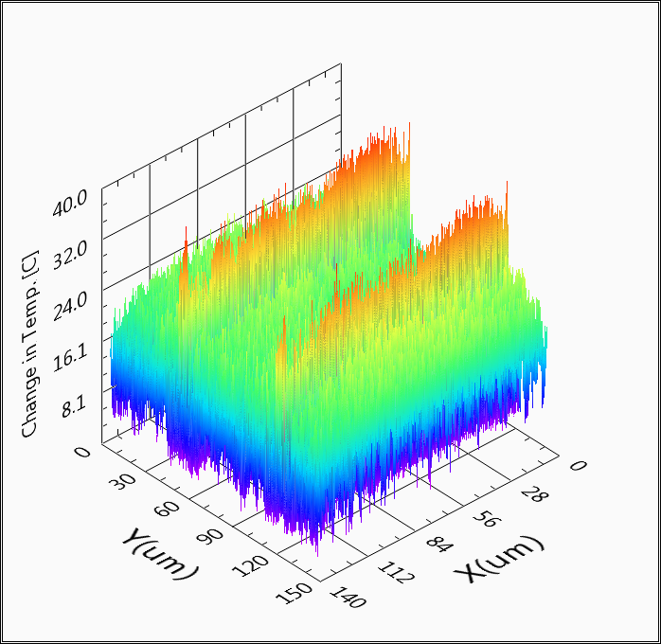
Transient 3D Temperature Profiles
These images show the heat spreading from the gate/channel region to the source/drain region at 50µs and 500µs.
50us temperature map
500us temperature map

Slide 26
ESD Protection Devices
Copyright 2013 Microsanj, LLC All rights reserved.

Slide 27
100 ns temporal resolution of
ESD-type event
∆T (˚C)
50µm
10µs
30µs
70µs
200µs
Non-uniform device turn on in a symmetrical Silicon Controlled Rectifier (SCR) in response to a 2.5 ms pulse
ΔT [K]
20
Initial response to the 300 ns 120V pulse shows highly localized heating.
15
Cathode
Anode
10
25µm
300ns
5
K. Maize, V. Vashchenko et al, IRPS, 2011.
0
(a) SCR optical image
(b) SCR thermoreflectance in snapback after 300ns at 1.28A

Slide 28
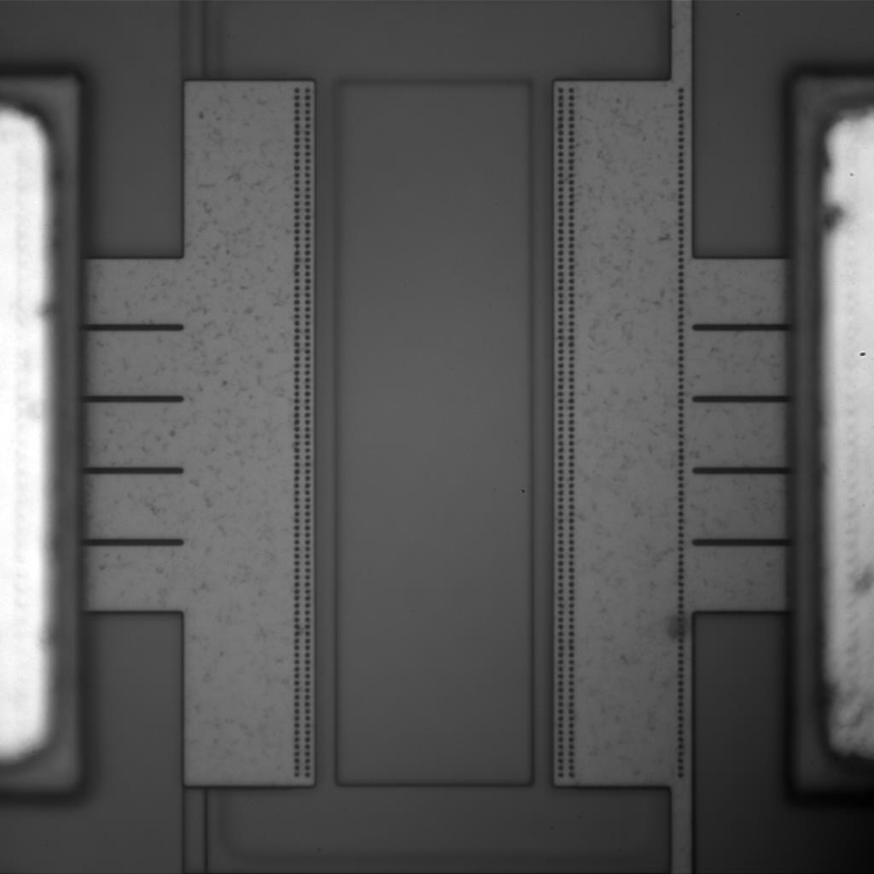
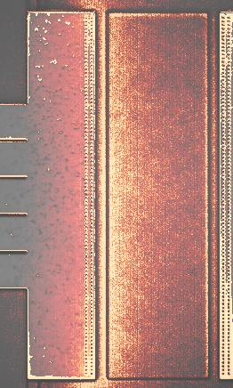
SCR Thermoreflectance Images
100x Optical Image
Optical and Thermal Image Overlay

Slide 29
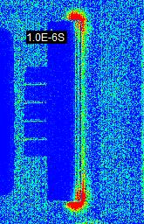
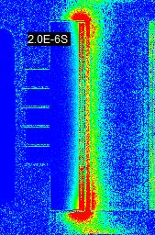
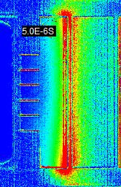
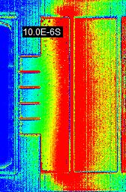
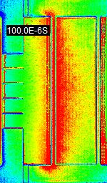
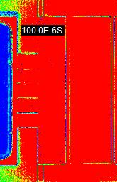
Transient SCR response
10V was applied to the device. The current and precise voltage across the device was not measured for this series
Scaled 100µs image to
Show temperature distribution
-These thermal images show the transient thermal response of the SCR.
-The SCR starts to conduct at the corners of the Anode (due to high electric field)
-Images are all on the same temperature scale
29

Slide 30
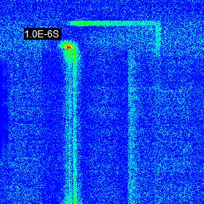
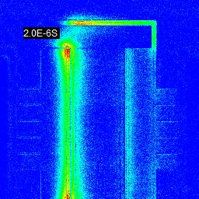
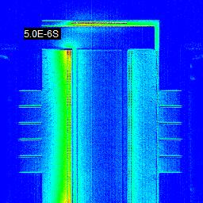
Transient SCR response
High Electric Field at sharp corners

Slide 31
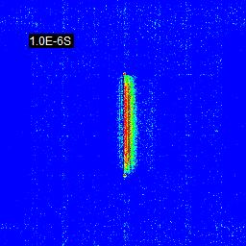
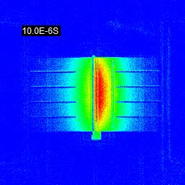
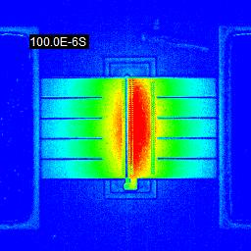
GGNFET Transient Images
- These are transient thermoreflectance images at 1, 10,
& 100 µs
- Each image is scaled to show the temperature
distribution.
31

Slide 32
GGNFET, 200ns, 30V pulse
This shows the temperature rise (a.u.) of the GGNFET in response to a 200 ns 30V pulse

Slide 33
Photonics and Power device examples
LEDs
  single junction, encapsulation, multi junction
Multi junction PV cell
InP laser device (cross section)
Power transistor array

Slide 34
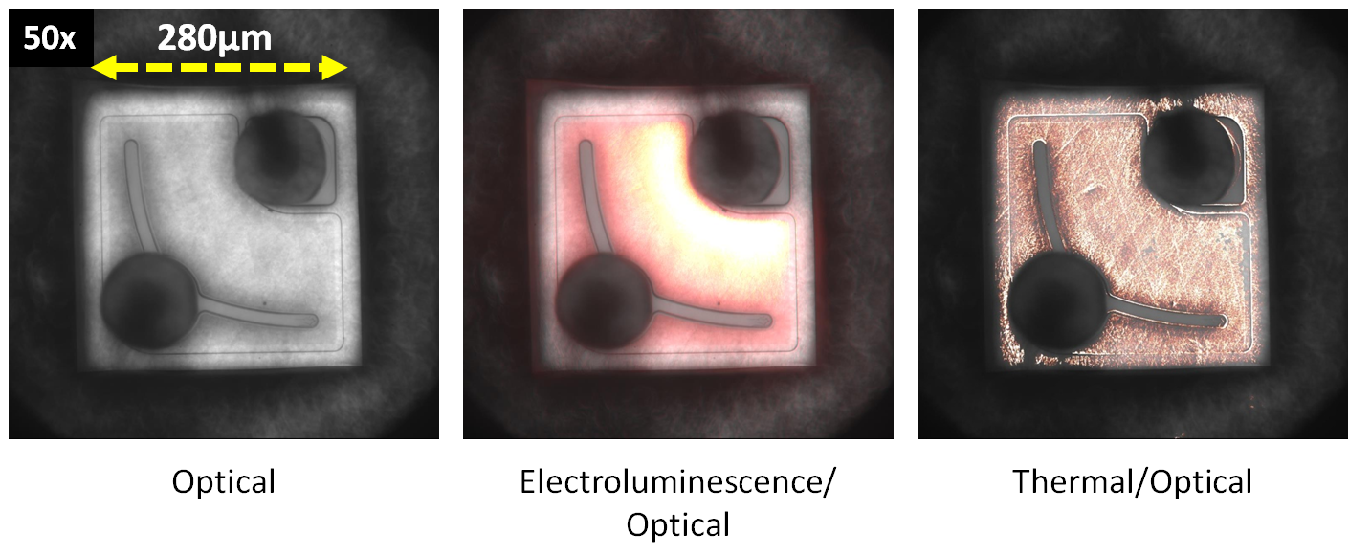
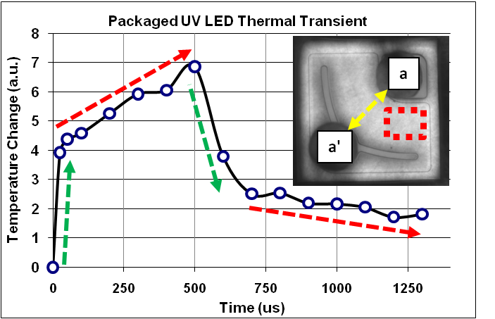
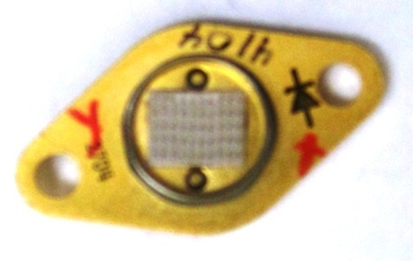
Separating electroluminescence and thermal information
D. Kendig et al, SemiTHERM, 2011

Slide 35
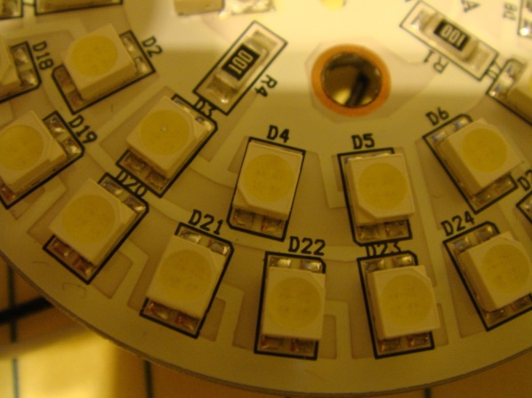
Thermal imaging of an encapsulated LED
Non-calibrated thermal image
Electroluminescence Image
10x

Slide 36
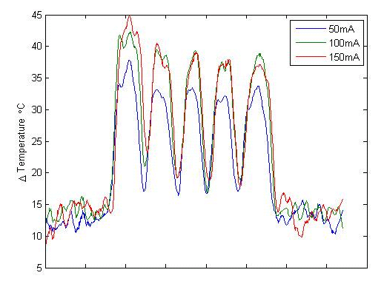
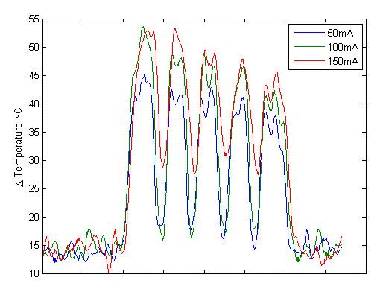
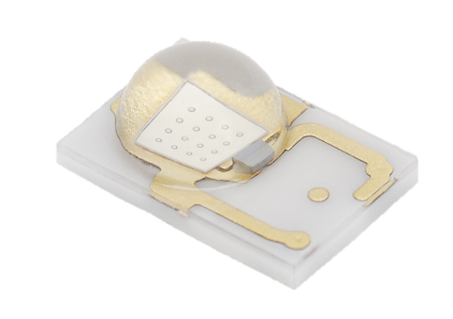
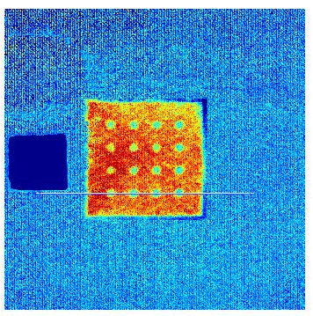
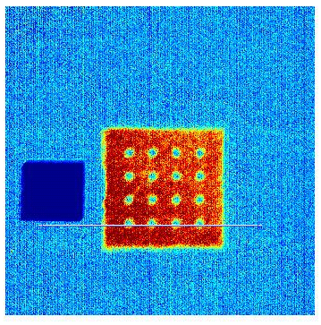
Transient thermoreflectance Imaging on LED
LED1
LED2
LED
peak 447.5nm
a
a’
a
a’
There seems to be more heating closer to the electrodes
a
a’
a
a’

Slide 37
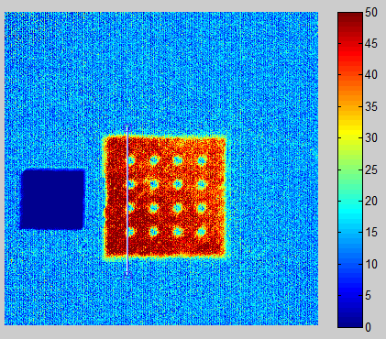
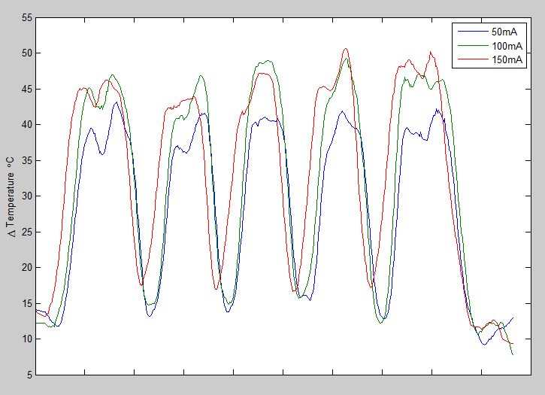
Temperature profiles – another section
a
a
a’
a’
In the Y direction profile, the heating is more uniform.

Slide 38
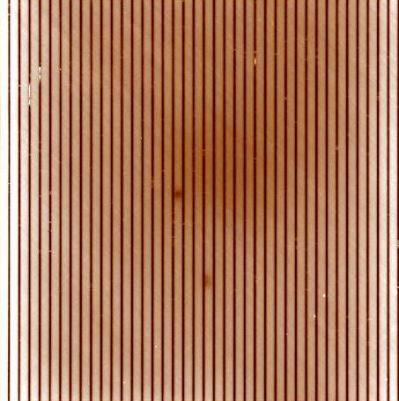
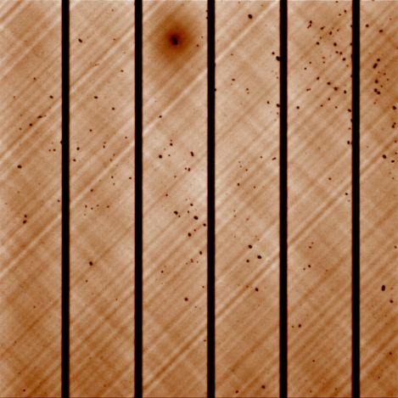

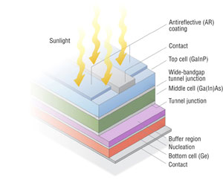
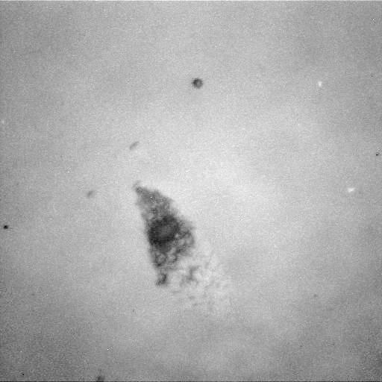
Multi-junction PV
Emission at forward bias 3V, 140mA
emission
optical
1.25x
20x
20x
=
125 microns
Device structure
250x
This is hard to find by
optical inspection only
10 microns
DoE SunShot initiative
http://www1.eere.energy.gov/solar/sunshot/pv_high_efficiency.html

Slide 39
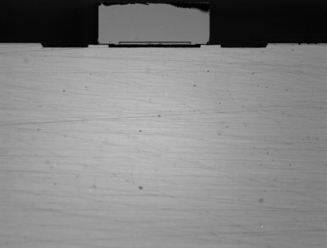
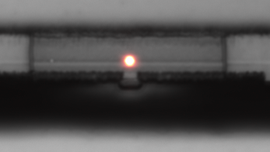
InP Laser device (cross section) with 530nm and 470nm LEDs
250x
Areas of interest (0.5 mm x 1 mm)
In flip chip package
Forward diode voltage 0.73V

Slide 40
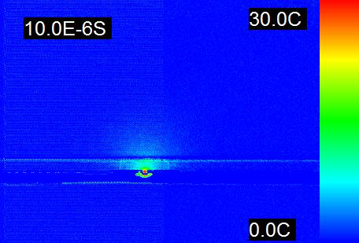
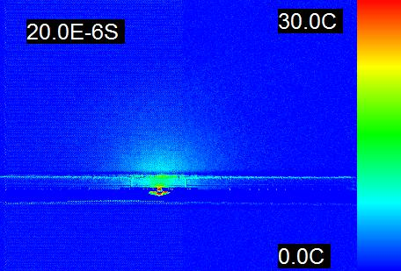
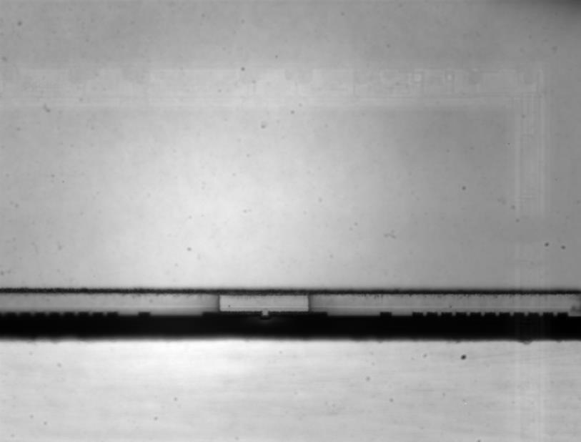
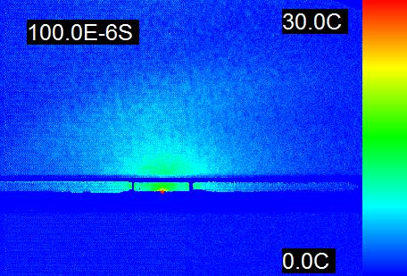

250mA transient thermal images at 10, 20, 100, 200μs
100x

Slide 41
Transient response (250mA pulse)
100x, 10us
A
A: InP substrate
B: InP based modified material
B
Temperature change [K]
Time [sec]

Slide 42

Thermoreflectance coefficient characterization for new materials
InP: Fe doped

Slide 43



High Power MOSFET Transistor Array
“Thermal Characterization of High Power Transistor Arrays”, K. Maize et al, 25th IEEE SEMI-THERM Symposium, 2009.

Slide 44

Thermal image vs. simulation at low bias
Vd = 0.5V, Id ≈ 0.5A 6 amps/mm²
b
0.65
a
0.6
0.55
0.5
0.45
0.4
0.35
a’
0.3
0.25
The magnitudes of temperature rise at both source and drain are in a good agreement.

Slide 45


Array heating at low & high current densities
LOW BIAS
HIGH BIAS
6 A/mm²
V_{D}=500mV, I_{D}=545mA
47 A/mm²
V_{D}=5V, I_{D}=4.2A
Thermo-reflectance thermal images
400μm
400μm
a
a’
b
b’
ΔT [°C]
ΔT [°C]
0
0.2
0.4
0.6
0
20
40
60
0.7
Δ Temperature [°C]
70
Δ Temperature [°C]
Δ T profile from a to a'
Δ T profile from b to b'
0.6
60
Δ Temperature [°C]
Tempera-ture profile along array
0.5
50
0.4
0.3
40
0.2
30
a
Distance
a’
b
Distance
b’
“Thermal Characterization of High Power Transistor Arrays”, K. Maize et al, 25th IEEE SEMI-THERM Symposium, 2009.

Slide 46

Comparison of topside and backside heating
Thermal images
Topside
100µm
6X
Backside
(InGaAs CCD)
drain contact
source contact
Near-IR Light
K. Maize et al, SemiTHERM 2010 and IHTC 2010.

Slide 47

Microsanj Products

Slide 48
Key System Specifications
1. Requires optical table mount
Product specifications & configurations are subject to change.

Slide 49


Slide 50
Publications
Bias-Dependent MOS Transistor Thermal Resistance and Non-Uniform Self-heating Temperature
Si/Ge uni-traveling carrier photodetector
High-power high-linearity flip-chip bonded modified uni-traveling carrier photodiode
Time and Frequency Domain CCD-Based Thermoreflectance Techniques for High-Resolution Transient Thermal Imaging
Understanding the Thermoreflectance Coefficient for High Resolution Thermal Imaging of Microelectronic Devices
High Speed Transient Thermal Imaging of Microelectronic Devices and Circuits
Thermal Characterization of High Power Transistor Arrays
Time and Frequency Domain CCD-Based Thermoreflectance Techniques for High-Resolution Transient Thermal Imaging
Thermoreflectance Imaging of Defects in Thin-Film Solar Cells
Thermal Imaging of Encapsulated LEDs
Quantum Electronics Group, Jack Baskin School of Engineering at UC Santa Cruz
Thermal Imaging for Reliability Characterization of Copper Vias
Ultrafast Submicron Thermoreflectance Imaging
More information at http://microsanj.com/news-and-papers
50

Slide 51
Summary
Introduced thermoreflectance imaging corresponding to challenges on thermal characterization of electronics devices.
Discussed the transient thermal characterization in 2D images in sub-micron length scale.
Demonstrated the thermal characterization of photonic devices and power devices.

Slide 52

Microsanj社の 開発した熱画像解析装置、Nanothermシリーズは、これまでのIRによるサーモグラフィー装置とは 全く異なった温度測定技術を用いたシステムです。測定物のIR放射を測定するのではなく、 測定物に非常に短時間の光を照射し、その反射光を計測することにより温度分布を測定するため、 測定物に全く影響を与えること無く、IRでは難しかった広い温度範囲を非接触にて測定することが 可能となりました。測定は金属を含むあらゆるものが可能で、測定物を熱したり、表面に特別な処理を 行う必要が有りません。また、薄いシリコン基板は光を透過することから、flip-chip等の、シリコン基板上の 半導体の熱画像を裏面から観測することが可能です。また、Nanothermシステムの最大の特徴として、 オプションにてバイアス電源と信号源を追加することにより、熱画像の過渡特性を、最速では0.8nsec間隔で 測定することができます。Nanothermシステムにより、温度上昇、熱集中の状況をリアルタイムに観察することで、 半導体そのものや半導体回路の最適な熱設計を行うこと、また故障解析、不良解析を行うことが可能です。 測定物の大きさは最小300nm、温度分解能は最小0.2℃、測定温度範囲-265～500℃に対応します。
ATN Japan
1-35-16 Nakagawa-Chuo
Tsuzuki, Yokohama, Kanagawa, 224-0003 JAPAN
Website: www.atnjapan.com
E-mail: sales@atnjapan.com

